Slide 1

A Point!

Slide 2

Graphics can:
Draw Attention
Make A Point
Increase Viewer Interest

Slide 3

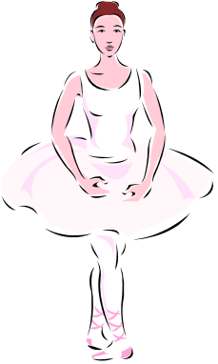





Graphics can also:
Distract Viewers
Confuse the Audience
Make it hard to read
Just Look Bad!

Slide 4

You can also add a photo from outside Clip Art

Slide 5
You can make your slides nicer using backgrounds

Slide 6


Just be careful – backgrounds can also be confusing or distracting!

